Slide 1
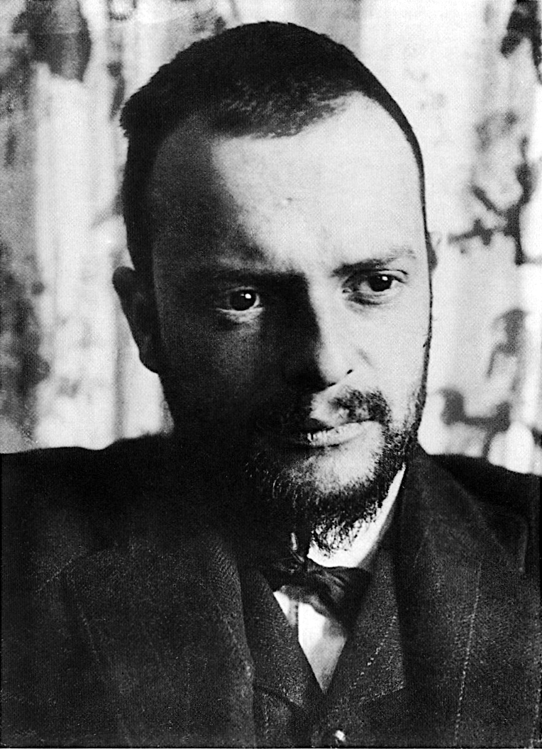
Paul Klee 1879-1940
Born in Switzerland
Taught at Bauhaus
Art and design school in Germany
Closed by Nazis in 1933
Nazis targeted him so he left teaching
Fascinated by children’s drawings
Created over 9000 works of art

Slide 2
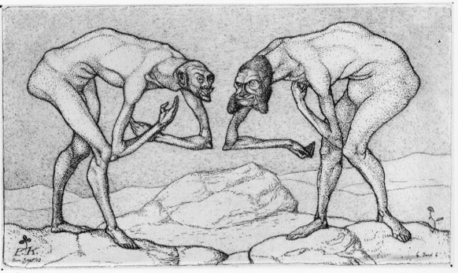
Two Men Meet Each Other Supposing The Other to be of Higher Rank (1904)
Early work mostly pen & ink drawings and etching (using acid to mark plates, glass or metal for the purpose of printing)
Early work shows mastery of human form.

Slide 3
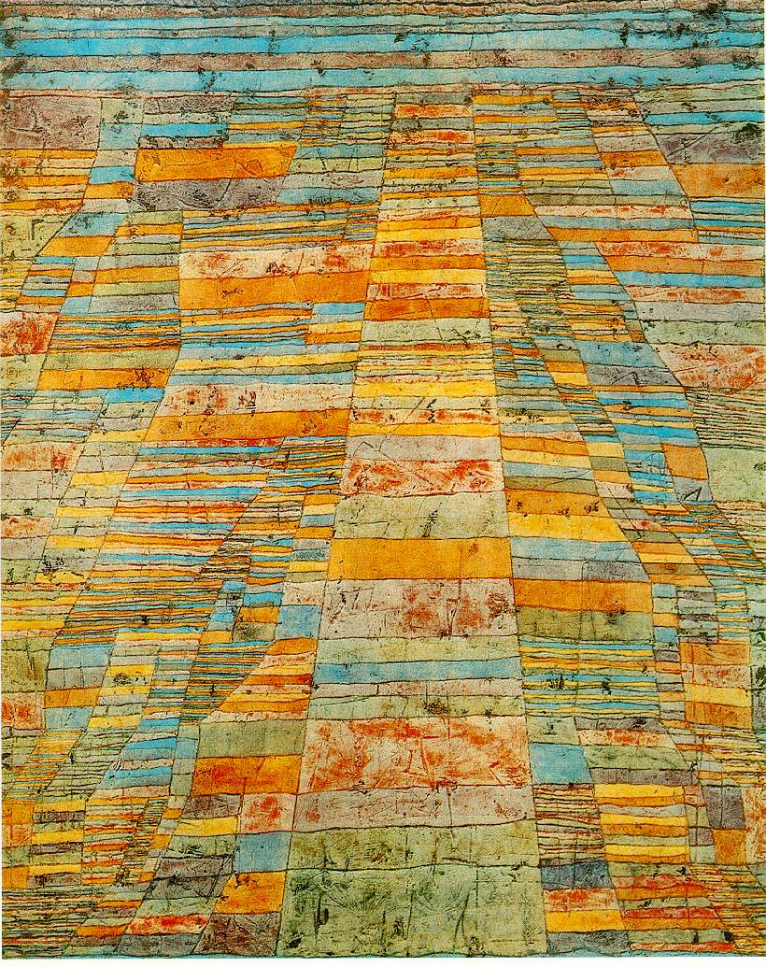
Highway and Byways (1929)
Experience in Tunisia inspired Klee to work with color more seriously
Some Later work was very abstract focusing on color

Slide 4
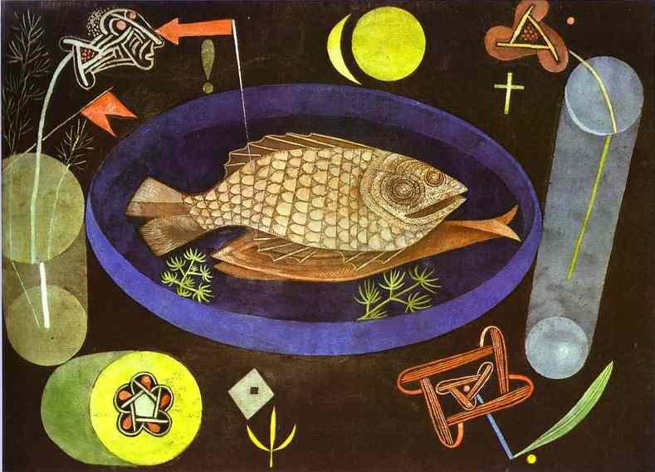
Around the Fish - 1926
Klee is famous for his writings on color theory and for the rich symbolism in his work.

Slide 5
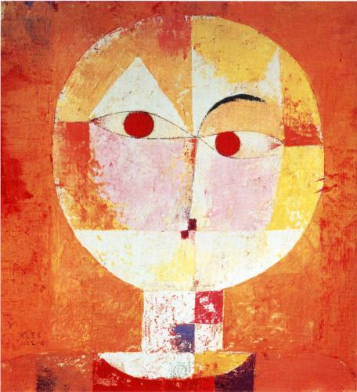
Senecio - 1922
Other work was made in a Cubist Fashion with continued emphasis on color
Klee was a master of color, texture and creating interesting surfaces.

