Slide 1
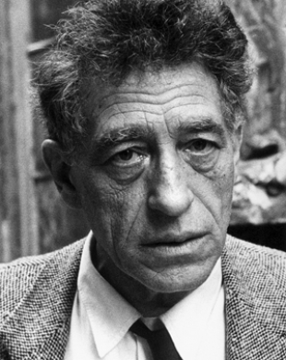
Alberto Giacometti 1901-1966
Swiss sculptor, painter, draughtsman & printmaker
Son of a famous Post-Impressionist Painter
Studied under Antoine Bourdelle, associate of Auguste Rodin (sculpted the Thinker)
Came to be regarded as a leading surrealist sculptor though he was later excommunicated from their ranks. (remind Dali)
Died from heart disease
Influential thinker

Slide 2
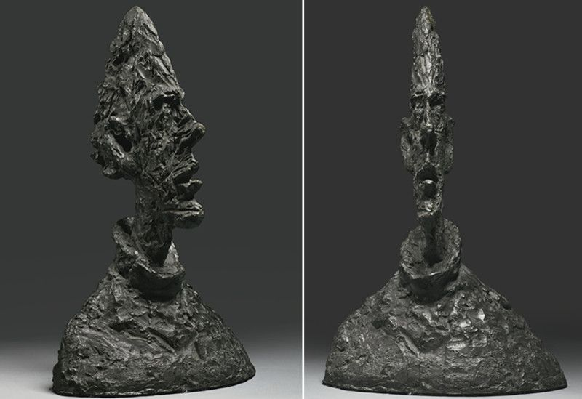
His work moved from extremely realistic in his youth and became increasingly more abstract. This is regarded as an existential struggle not a technical deficiency. One friend sad that if Giacometti sculpts you he will make your head look like the blade of a knife.

Slide 3
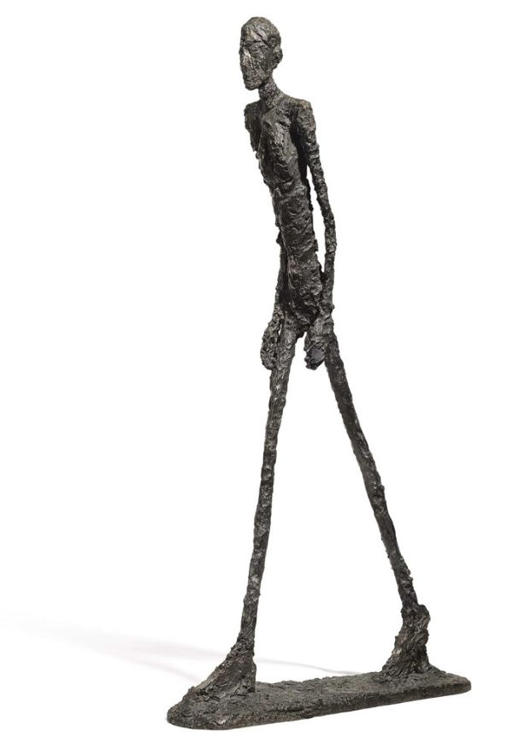
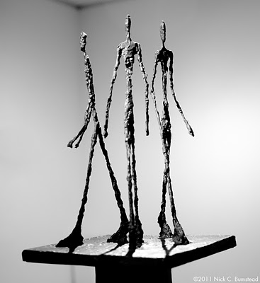

Slide 4
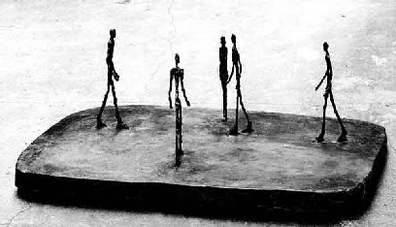
What do you see and what could it mean?

Slide 5
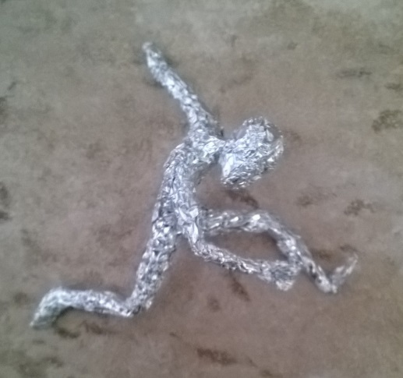
Here we go!

